Slide 1

Deep Dive of Housing in India (Exploratory Data Analysis and Modelling)
Part A - Comprehensive Analysis of India Housing Census Data 2011
The objective of Part A is for you to perform the following:
EDA & Visualization Dashboard of the variables provided
Part B - Housing Price Prediction from Metropolitan Indian Cities
The objective of Part B is for you to perform the following:
Construct and compare at least 3 models to predict the pricing of houses from Metropolitan Indian Cities
Perform feature reengineering to increase the accuracy of your models. Some features to add would be House Quality Living Index (Refer to the Appendix below) by using the Census dataset or other features using the comprehensive Census dataset provided.
This dataset comprises data that was scraped. It includes:
collection of prices of new and resale houses located in the metropolitan areas of India
the amenities provided for each house
Submitted by
Team Moonknight: Abhineet Sharma, Adarsh Roy, Lokadithya Reddy, Raghav Sahni

Slide 2
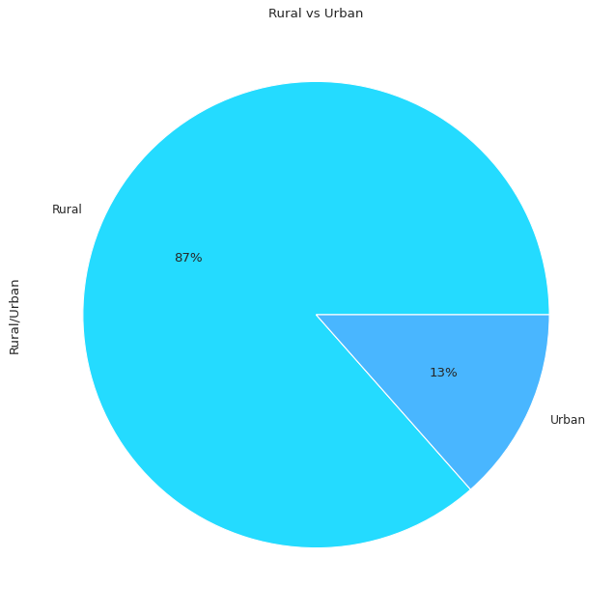
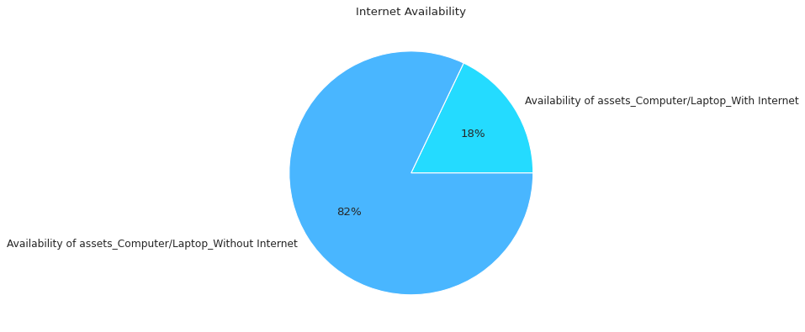
Part A - Comprehensive Analysis of India Housing Census Data 2011
The Availability of Internet in HouseHolds
Rural versus Urban Population Visualization

Slide 3
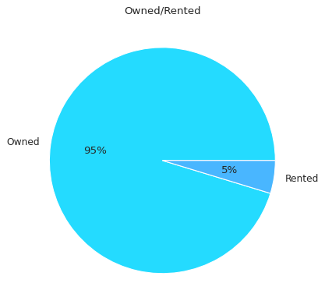
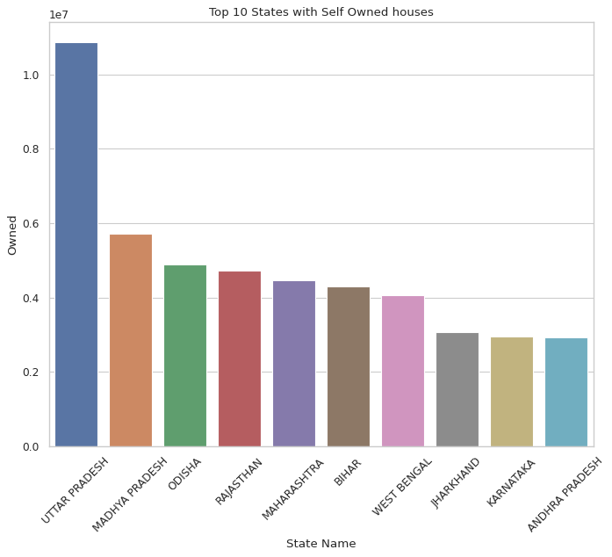
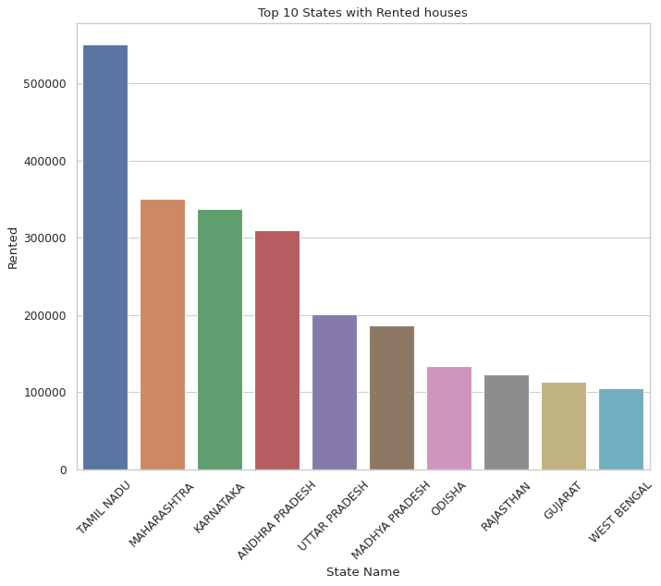
Exploratory Data Analysis for Housing based on Owned V/s Rented

Slide 4
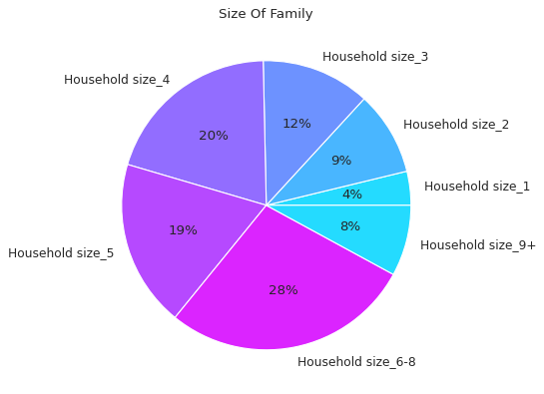
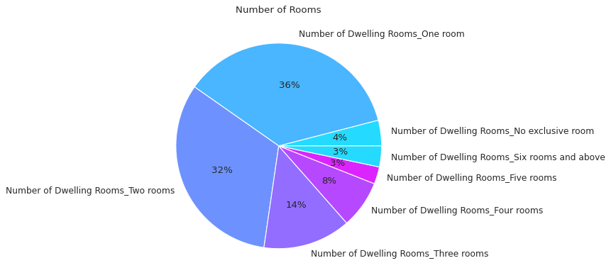
Size Comparison of families in the Indian Household

Slide 5
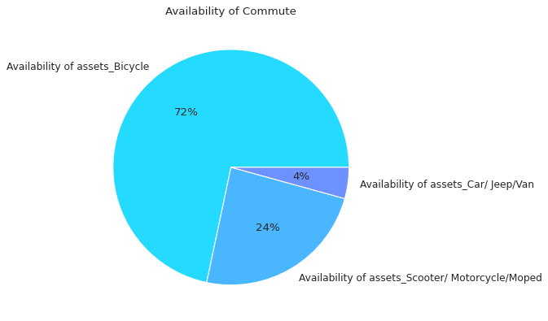
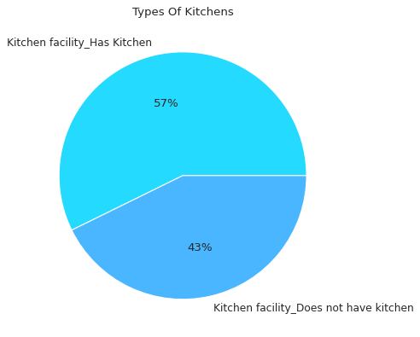
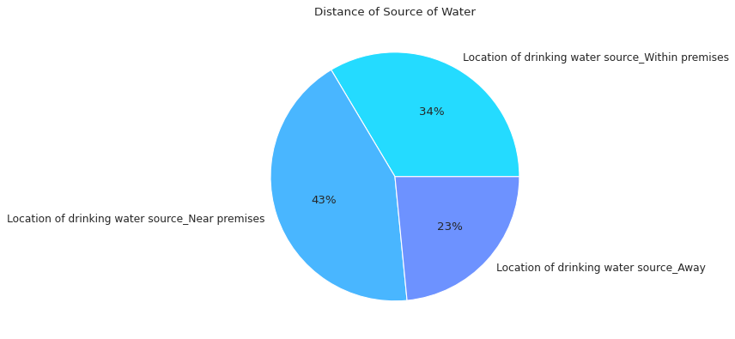
1. The First Pie Chart represents the share of assets and their Availability.
2. The Second pie chart represents the share of households having a Kitchen and the ones that don’t.
3. Another important aspect i.e. Distance of source of water has been represented in plot 3

Slide 6
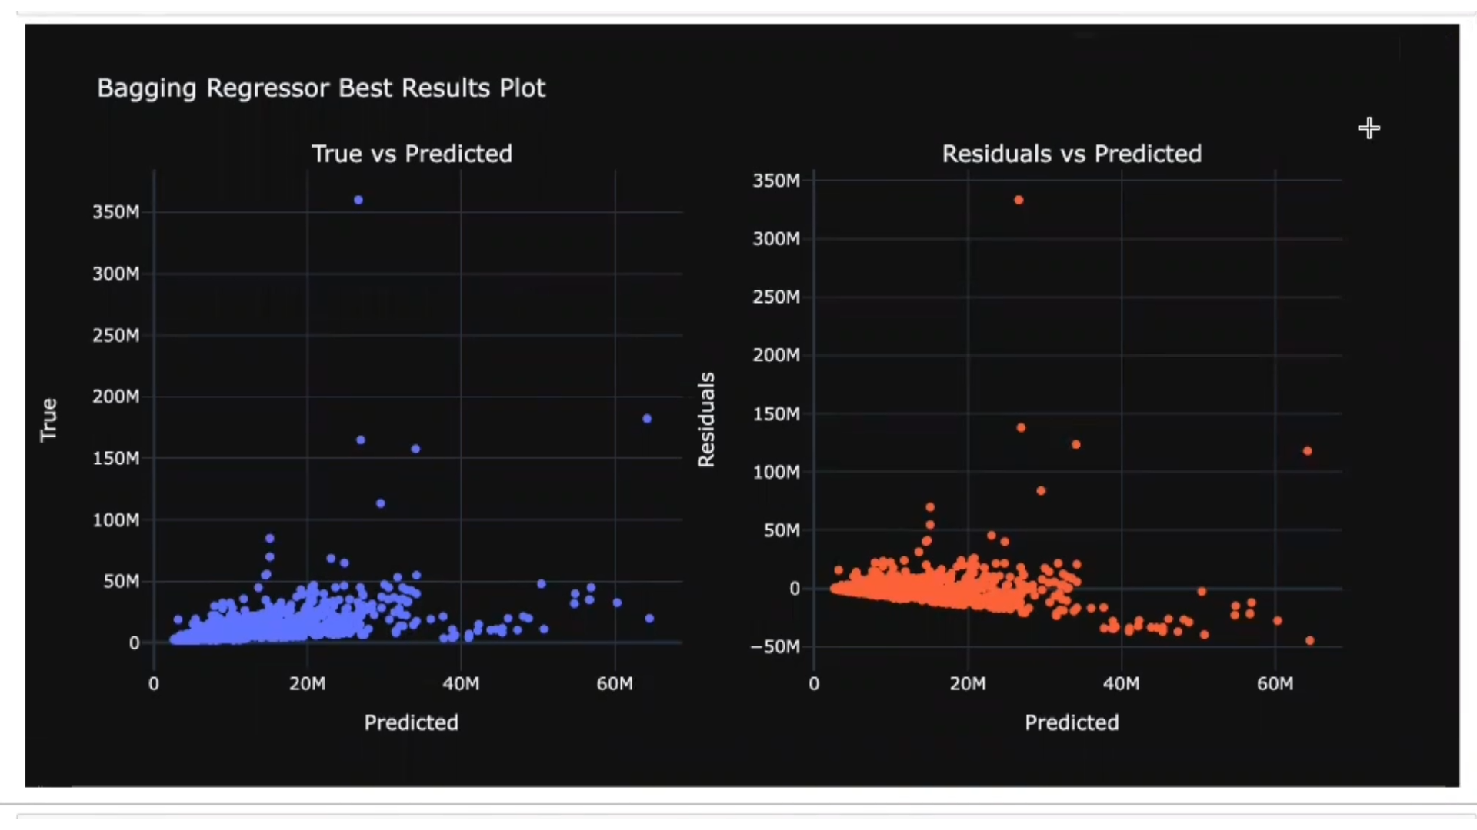
PART – B Modelling and EDA
Interactive plots for True vs Predicted price values and the Residual plots for a better model analysis.
These plots have been created for all four models
These plots are zoomable and have hovering features.

Slide 7
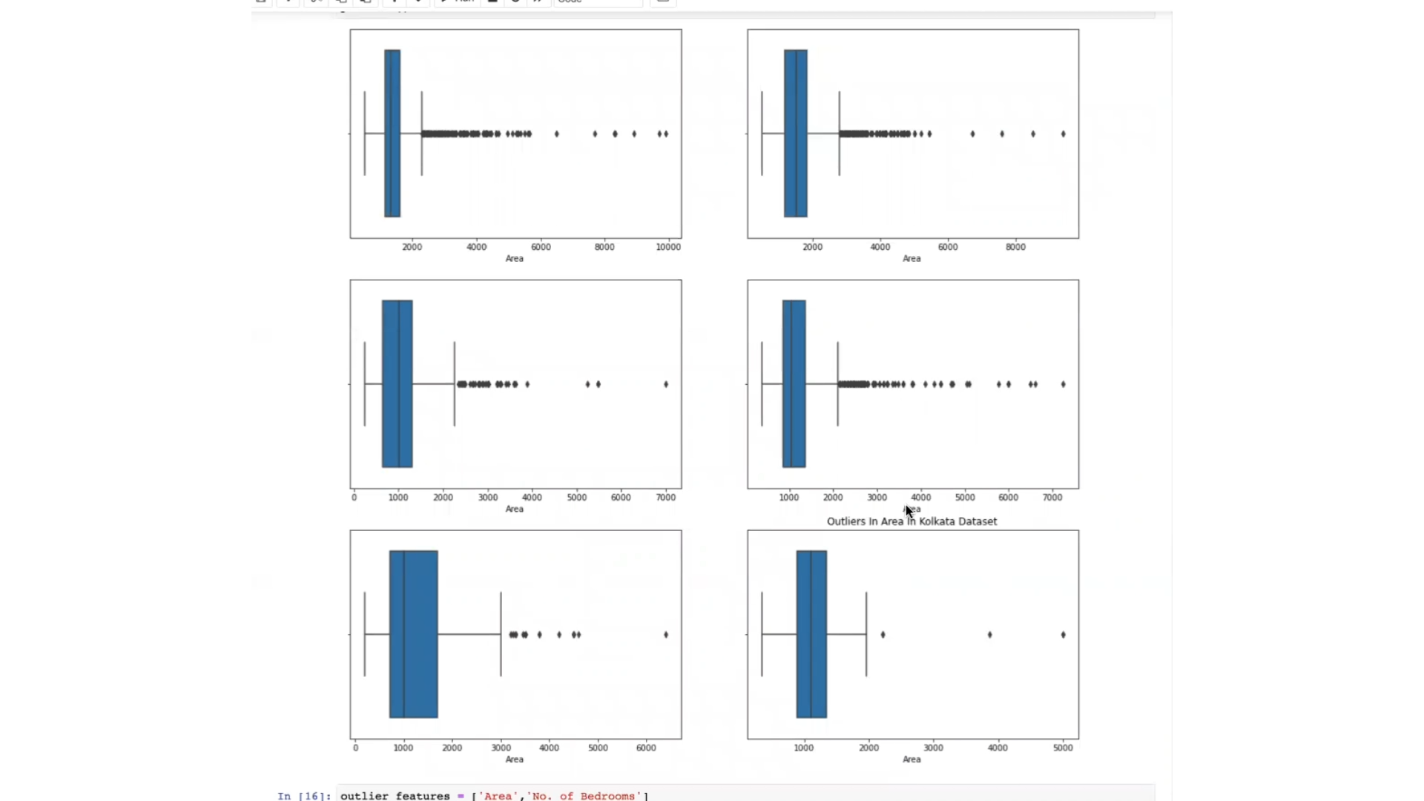
Outliers in the Housing Dataset for part B (represented using Boxplots)

Slide 8
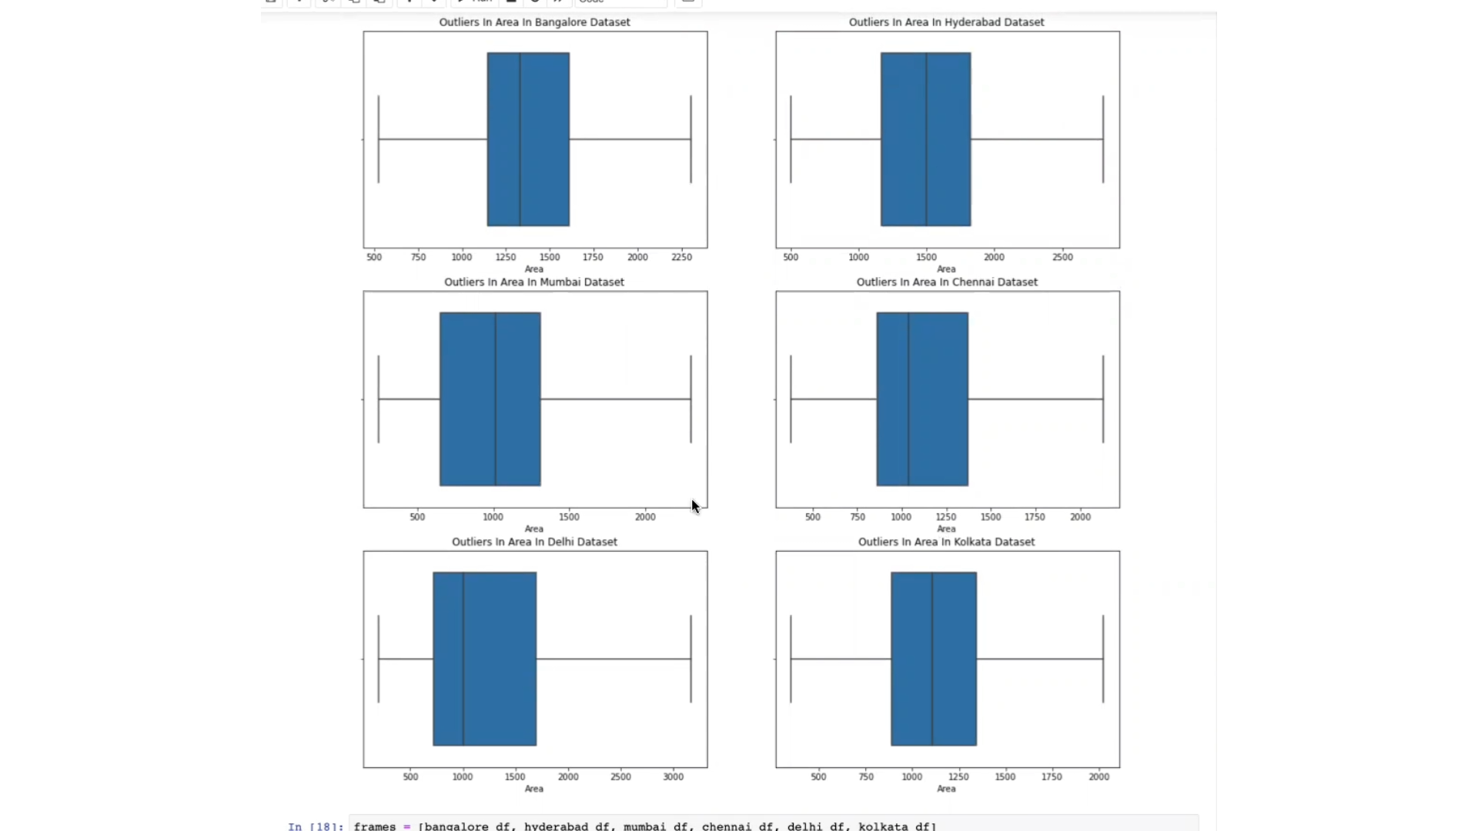
The Housing Dataset for part B (represented using Boxplots after the outlier removal)

Slide 9
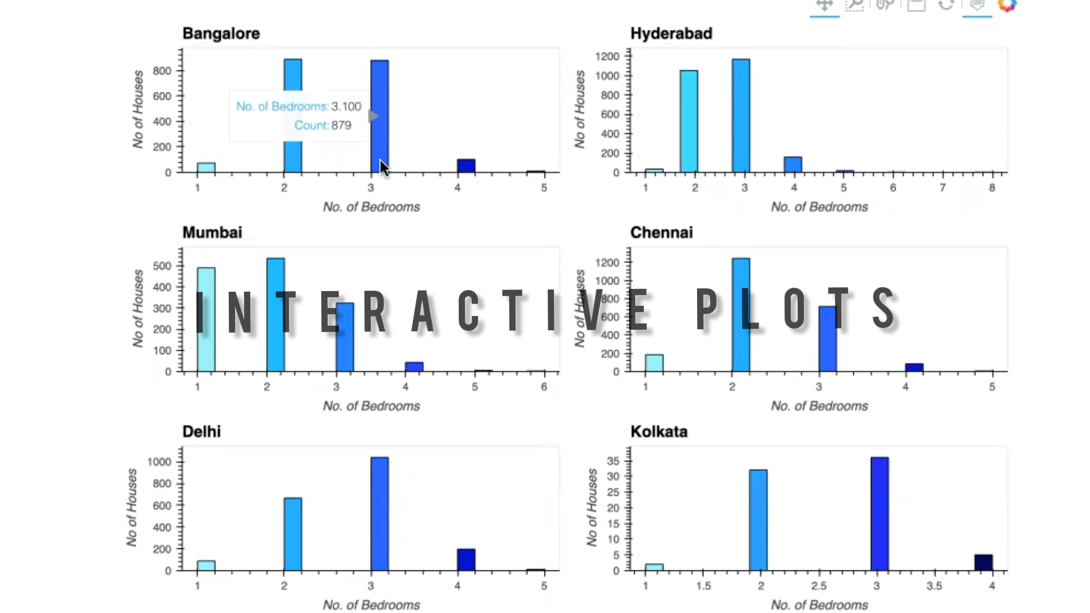

Slide 10
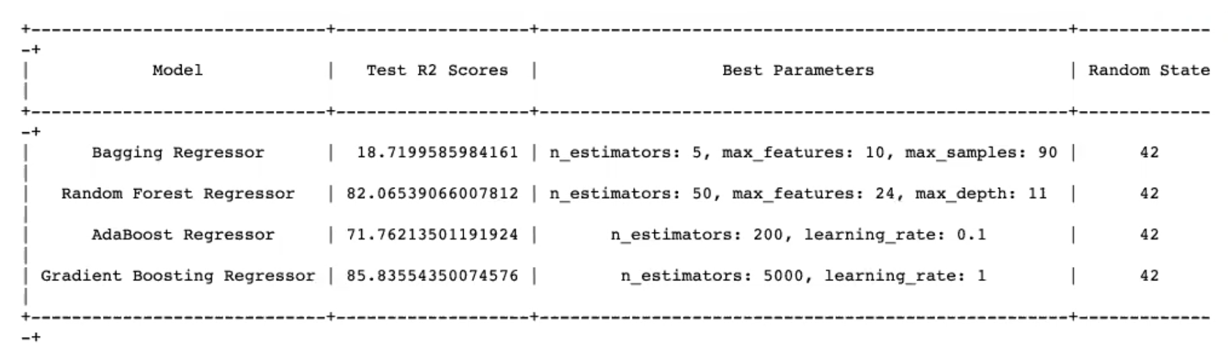
Conclusion
The best performing Model was the Gradient Boosting Regressor with the R2 score of 85.83
The worst performing Model was the Bagging Regressor with the R2 score of 18.71

